Slide 1


Slide 2

OUR TEAM
Dimitar Ivanov– 9A class
Scrum Trainer
Todor Zafirov- 9B class
Developer Back End
Ivan Ivanov- 9V class
Developer Front End
Андрей Андреев– 9G class
Web Designer

Slide 3

Steps of realisation
1. Goals
2.Organisation
2. Realisation
3. Presentation

Slide 4





USED TECHNOLOGIES

Slide 5
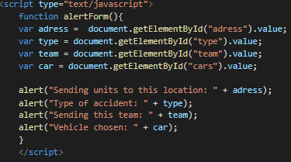
USED FUNCTIONS

Slide 6
THANK YOU FOR YOUR ATTENTION!

